Slide 1
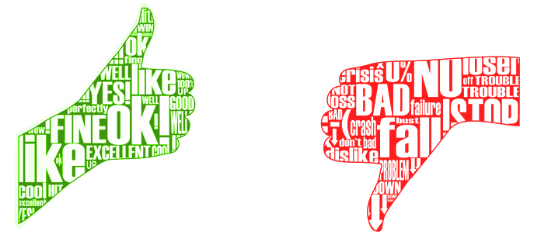
Sentiment Analysis on Amazon Reviews
Khalid Gharib

Slide 2
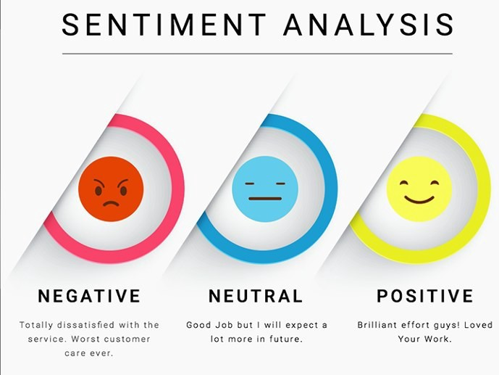

Slide 3
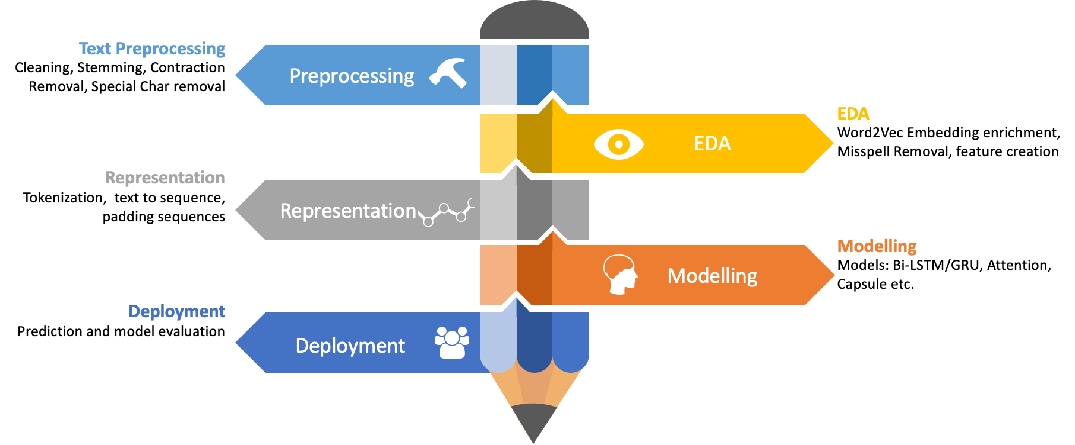

Slide 4
Pre-Processing Steps
Text
Tokenization
removal of noise
change to numbers
make sure all reviews are equal length

Slide 5
Why Sentiment Analysis?
Abundance of information online
Can help us identify sentiment for better audience engagement and understanding
Helps us see what user like and dislike and to capitalize or improve/change things
Helps determine marketing strategy
Niche opportunities such as finding next influencer

Slide 6
Business Goal
Categorise and summarize information efficiently
Variety of Data
Public opinion and sentiment on products, services
Help improve and develop PR for a company, product, service and even for political use

Slide 7
Outcome
My model predicted the correct sentiment with 90% accuracy for Amazon Reviews
Model can detect how heavily positive or negative the sentiment is
Model can detect misspelled words and take them into consideration when predicting sentiment

Slide 8
Further Work
I would like to develop a more complex neural network
better understand where my model is making errors
Add web scraping

Slide 9

Thank you!

Slide 10
References
https://www.linkedin.com/pulse/importance-sentiment-analysis-social-media-christine-day/
https://www.mondovo.com/blog/what-is-sentiment-analysis-and-why-is-it-important/
https://classroom.udacity.com/courses/ud188
https://www.coursera.org/learn/neural-networks-deep-learning/home/welcome

